Slide 1

Title of the Project
Smart Health Care Assistance Using Symptoms
Team Members:
1. GOWNI LIKITH – 202BCSE07AED130
2. B.NAGA UDDHAV – 2023BCSE07AED146
3. A.KARTHIK KUMAR REDDY 2023BCSE07AED132
4. D.GOWTHAM REDDY – 2023BCSE07AED181
Name of the Mentor: Dr. N Sengottaiyan
6CS1991 Design Project - 2

Slide 2

Introduction
A step toward smarter, faster healthcare.
Helps users understand symptoms and possible health risks.
Uses AI + Machine Learning to predict diseases early.
Offers simple, reliable preventive advice and self-care tips.
Designed to make healthcare accessible, personal, and proactive.

Slide 3
Problem Statement / Scope of the Project
People often misinterpret or ignore early symptoms, leading to delayed treatment.
Access to doctors and medical advice is limited in many areas.
Existing systems give basic symptom checks, but lack accurate prediction or prevention guidance.
There is a need for a smart, AI-based assistant that analyzes symptoms, predicts possible diseases,
and suggests safe, preventive actions.

Slide 4
Existing System
People rely on Google searches or self-diagnosis.
Hospital visits can be time-consuming and expensive.
Healthcare systems focus more on treatment than prevention.
Limited access to doctors in remote areas.

Slide 5
Proposed Solution
To predict possible diseases from user-reported symptoms using Machine Learning.
To understand symptoms using Natural Language Processing (NLP).
To provide safe, preventive health suggestions and home remedies.
To encourage early diagnosis and self-awareness among users.
To create a simple, user-friendly interface for real-time health interaction.
To support data-driven healthcare accessibility, especially in underserved areas.

Slide 6
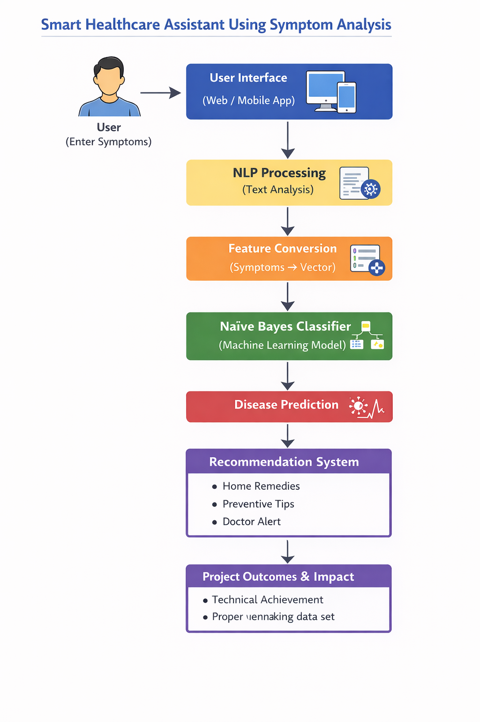
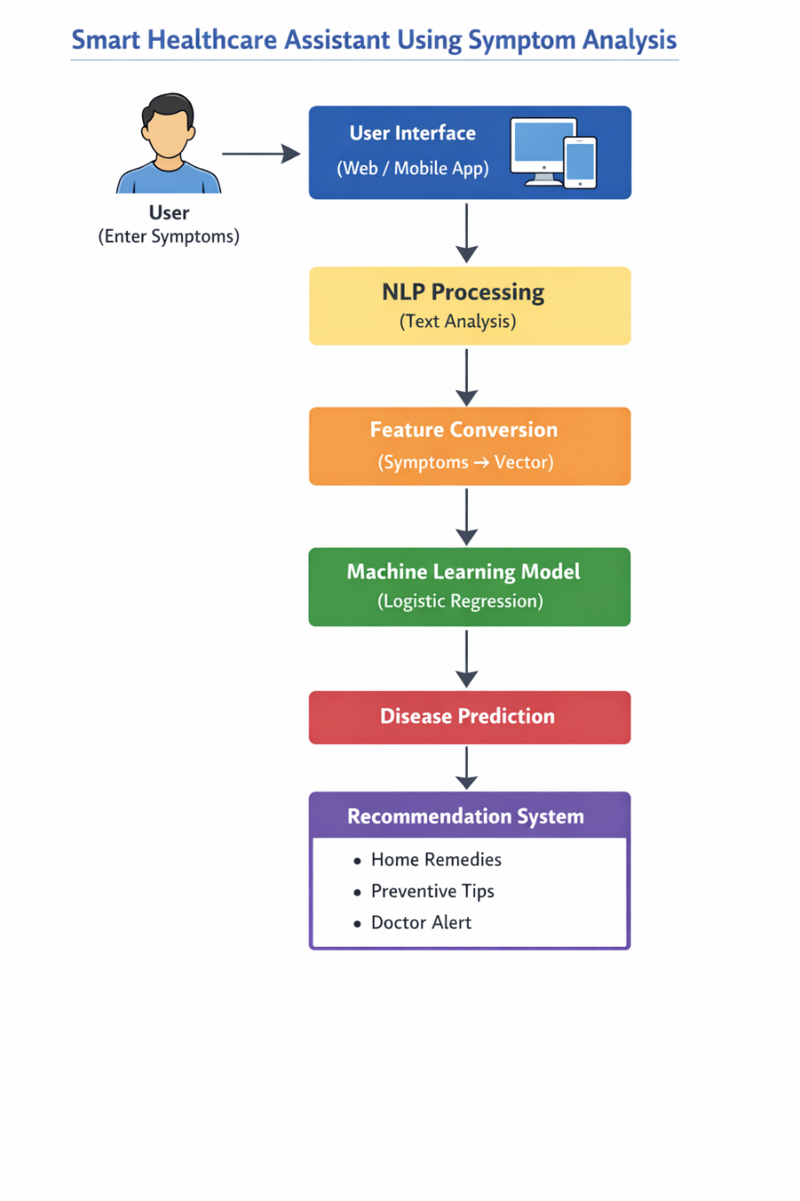
Architecture

Slide 7
Technology Stack
Programming Language: Python
Machine Learning: Logistic Regression
NLP: Natural Language Processing
Framework: FastAPI
Libraries: Scikit-learn, Pandas, NumPy

Slide 8
Key Features
Symptom-based disease prediction
AI-powered health recommendations
Early disease awareness
User-friendly interface
Preventive healthcare suggestions

Slide 9
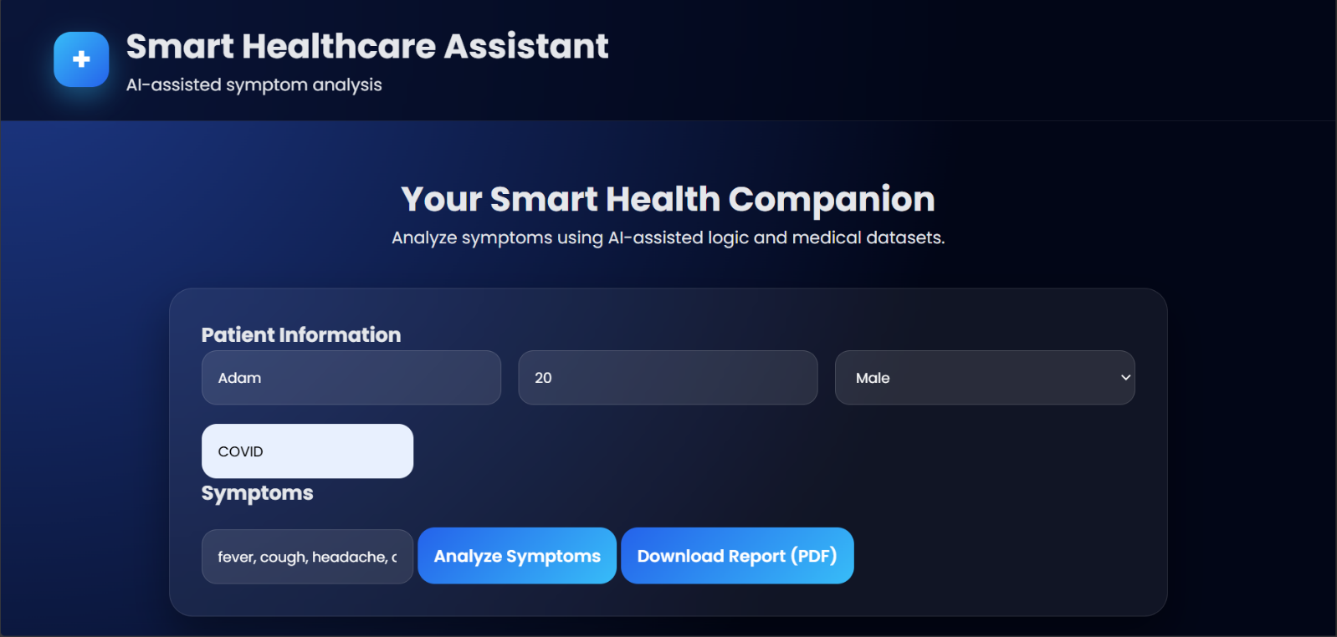
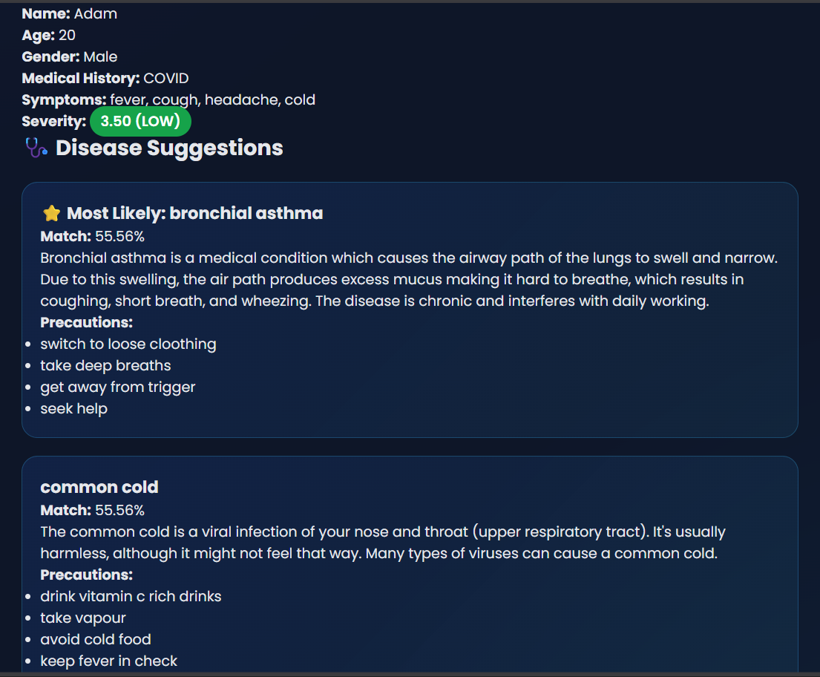
Demo Screenshorts

Slide 10
Results
System predicts diseases based on symptoms.
Provides preventive health advice.
Helps reduce unnecessary hospital visits.
Improves health awareness.

Slide 11
Conclusion
The project shows how AI and NLP can make healthcare simpler, smarter, and more accessible.
Helps users understand symptoms, predict diseases, and take preventive action early.
Focuses on non-prescriptive, awareness-based guidance for safe health decisions.
Uses cloud technology for secure, real-time access anywhere.
Reduces the burden on hospitals by encouraging self-care and early diagnosis.
Paves the way for future integration with IoT, wearables, and telemedicine systems.

